Slide 1
Data Encryption Standard (DES)
Network Security

Slide 2
Data Encryption Standard (DES)
Objectives of the Topic
After completing this topic, a student will be able to
describe data encryption standard.

Slide 3
Data Encryption Standard (DES)
Figures and material in this topic have been
adapted from “Network Security Essentials: Applications and Standards”, 2014, by William Stallings.

Slide 4
Data Encryption Standard (DES)
A block cipher processes plaintext input in fixed-sized blocks and produces a block of ciphertext of equal size for each plaintext block.
The two users share a common encryption key.
DES is an example.

Slide 5
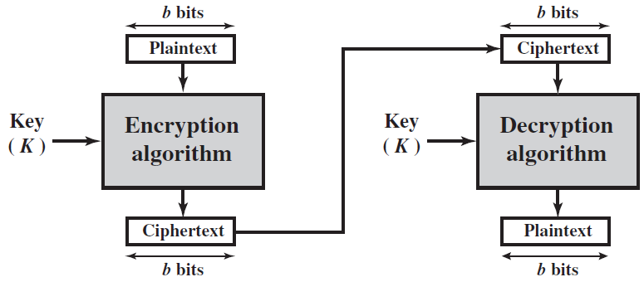
Data Encryption Standard (DES)
Block Ciphers

Slide 6
Data Encryption Standard (DES)
Data Encryption Standard (DES) was issued in 1977 as Federal Information Processing Standard 46 (FIPS 46) by the National Institute of Standards and Technology (NIST).

Slide 7
Data Encryption Standard (DES)
DES Encryption
Data are encrypted in 64-bit blocks using a 56-bit key.
The algorithm transforms 64-bit input in a series of steps into a 64-bit output.

Slide 8
Data Encryption Standard (DES)
There are two inputs to the encryption function: the plaintext to be encrypted and the key.
The function expects a 64-bit key out of which only 56 are used; other 8 bits can be set arbitrarily.

Slide 9
Data Encryption Standard (DES)
Plaintext proceeds in three phases.
First, the 64-bit plaintext passes through an initial permutation (IP) that rearranges the bits to produce the permuted input.

Slide 10
Data Encryption Standard (DES)
The 2nd phase consists of 16 rounds of the same function, which involves both permutation and substitution functions.
The output of the last round consists of 64 bits that are a function of the input plaintext and the key.

Slide 11
Data Encryption Standard (DES)
The left and right halves of the output are swapped to produce preoutput.
Finally, the preoutput is passed through a permutation that is the inverse of the initial permutation function, to produce the 64-bit ciphertext.

Slide 12
Data Encryption Standard (DES)
Subkey Generation
Initially, the key is passed through a permutation function.
Then, for each of the 16 rounds, a subkey (K_{i}) is produced by the combination of a left circular shift and a permutation.

Slide 13
Data Encryption Standard (DES)
The permutation function is the same for each round, but a different subkey is produced because of the repeated shifts of the key bits.

Slide 14
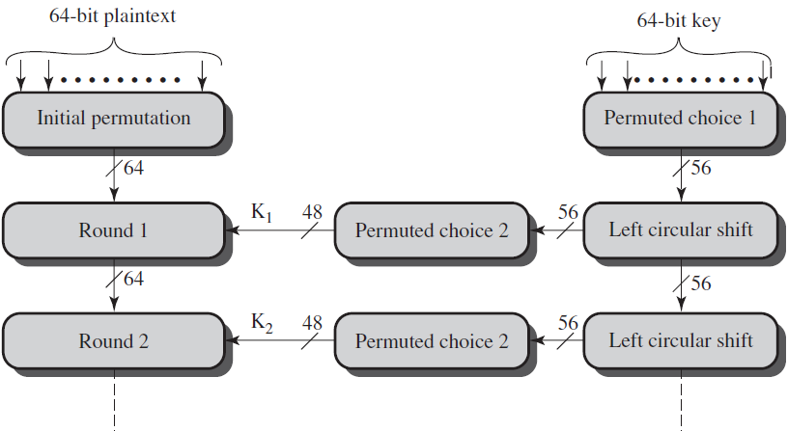
Data Encryption Standard (DES)
Working of DES

Slide 15
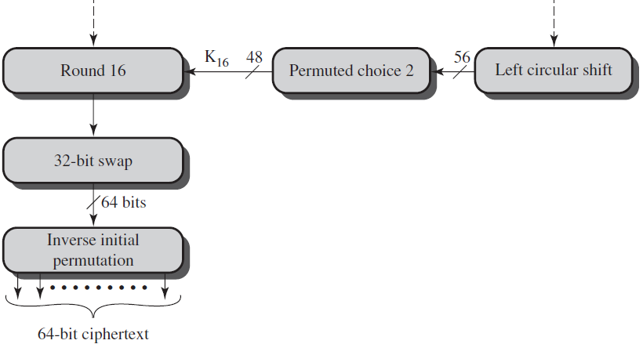
Data Encryption Standard (DES)
Working of DES

Slide 16
Data Encryption Standard (DES)
DES Decryption
It uses the same algorithm as encryption, except that the application of the subkeys is reversed.
Also, the initial and final permutations are reversed.

Slide 17
Data Encryption Standard (DES)
Concerns about DES
1.The algorithm itself
Refers to the possibility that cryptanalysis is possible by exploiting the characteristics of the algorithm

Slide 18
Data Encryption Standard (DES)
2.The use of a 56-bit key
2⁵⁶ = 7.2 × 10¹⁶ keys
Time required if PC works at 10⁹ decryptions/s, then 2⁵⁵ ns = 1.125 years.
Time required if PC works at 10¹³ decryptions/s, then 1 hour.

Slide 19
Data Encryption Standard (DES)
DES finally proved insecure in July 1998.
Electronic Frontier Foundation (EFF) have broken it using a machine that took less than three days.
End

